Slide 2
Increase Sales
With Penny tremblay
www.Pennytremblay.com
705-358-3396

Slide 3
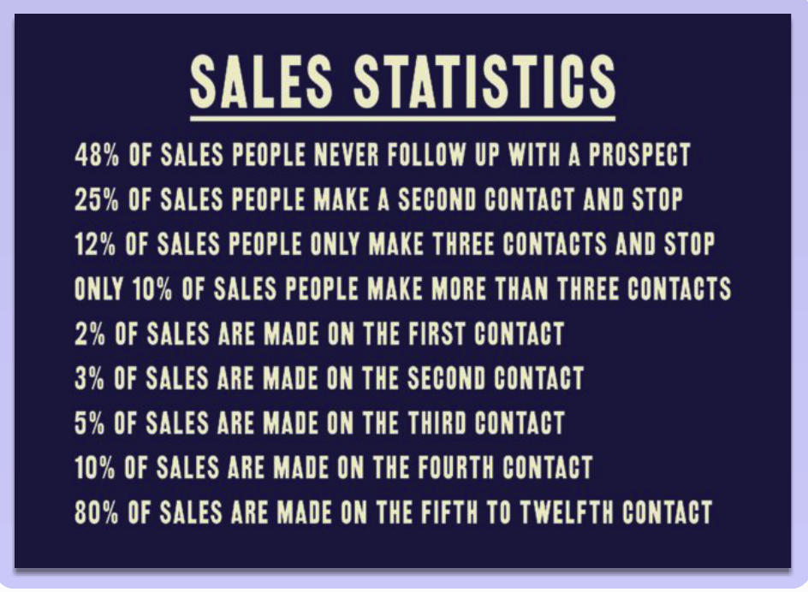

Slide 4
6 Habits to Increase Your Sales using Relationship Marketing
#1 - Who Do You Want to Meet?
#2 – Nail Your Elevator Pitch
#3 – Make Contact
#4 – Follow Up
#5 – Repeat step #4
#6 – Post-Sale Service

Slide 5
#1 - Who Do You Want to Meet?

Slide 6
#1 - Who Do You Want to Meet? List 25 people, full contact records
full name
email addresses
mobile phone number
snail mail addresses
social media hangouts

Slide 7
#2 - Nail Your Elevator Pitch

Slide 8
#2 - Nail Your Elevator Pitch
Very brief
Plant seeds of interest to them
Leave them wanting more information

Slide 9
#3 – make contact

Slide 10
5 Contacts / Day
More connections = More Sales
Get over your excuses
Time block and stick to your commitment

Slide 11
#4 – Follow Up

Slide 12
F.U. opportunities
Phone
Email
Text
Send mail (snail mail)
Gather for meeting
Coffee meet up
Go to their site
Follow them on social media
Send them information that interests them
(other ideas ??)

Slide 13
#5 – repeat step 4 until sale

Slide 14
80% of sales are made on the 5th to 12th contact
Keep track of your follow up efforts – 12x
Relationships are like gardening Plant seeds, water, nurture
Don’t stop unless they ask
Get over your excuses

Slide 15
#6 – Post Sale service

Slide 16
Post-Sale Service SYSTEM
Example
Send thank you card
Check in (repeat)
Set up future appointment / opportunity for business
Ask for feedback
Ask for testimonials
Ask for referrals
Send relevant information

Slide 17
Here is my system after a training session or keynote is delivered:
Review feedback forms and follow-up on any questions / comments
Send Thank You card to client
Send Referral gift to person who referred client
Offer ‘next step’ options for future training or conferences
Ask for referrals
Put into relationship marketing campaign to maintain connection

Slide 18
Email: va@pennytremblay For a copy of my e-book Networking Boot Camp

Slide 19
6 Weekly Group Coaching Sessions
Inquiries to:
VA@PENNYTREMBLAY.COM
705-358-3396
iwww.PennyTremblay.com
Notes:
SLIDE 1: WELCOME
Welcome everyone! Congratulations for taking such a positive step in changing your financial future by not only getting started with SendOutCards but by being here today.
Presenters Notes:
Depending on the size of the group, you may want to go around the room and have everyone introduce him or herself. This will show that all walks of life are represented in SendOutCards. The expectations for the training are to teach new distributors how to become a Manager within the next 30 days and qualify for the $50 Fast Start Bonus.
----------------------------------------------------------------------------------------------------------------------------

Slide 20
www.PennyTremblay.com

